Slide 1
Predicting High-Traffic Recipes
A solution for Tasty Bytes

Slide 2
Business Goals
A solution to predict which recipes will lead to website high traffic.
A solution to predict recipes which lead to high traffic 80% of the time.

Slide 3
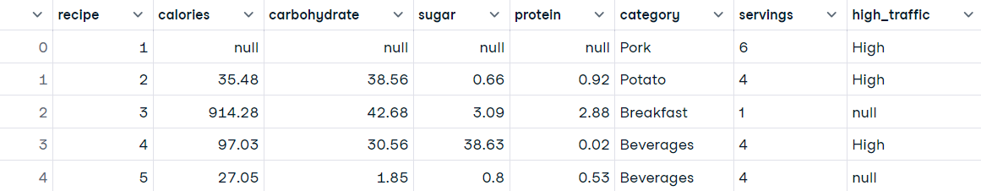
Data
The data provided

Slide 4
Data Cleaning
Deleted 23 duplicates
Filled 29 rows with missing data on calories, carbohydrate, sugar, protein
Changed ‘Chicken Breast’ to ‘Chicken’ in category
Changed ‘4 as a snack’ and ‘6 as a snack’ to ‘4’ and ‘6’ in servings

Slide 5
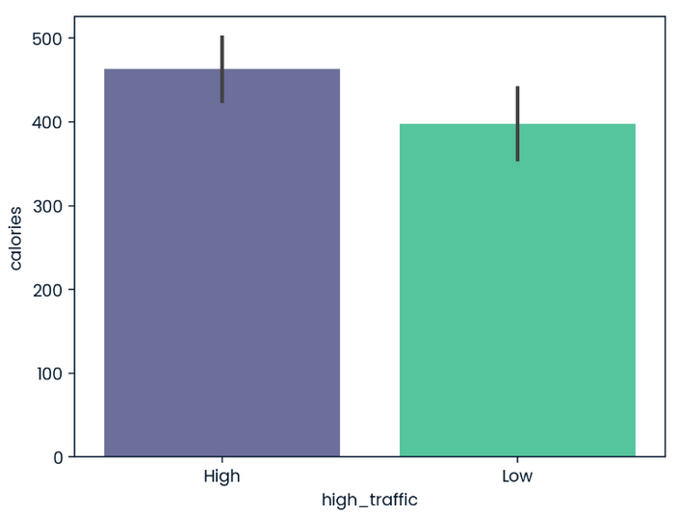
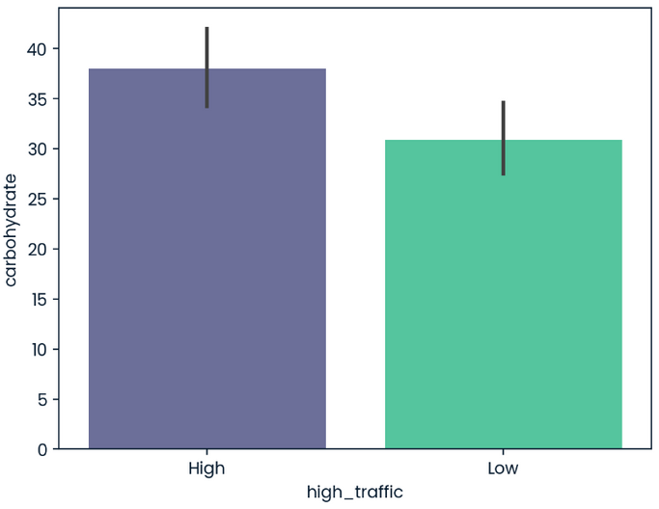
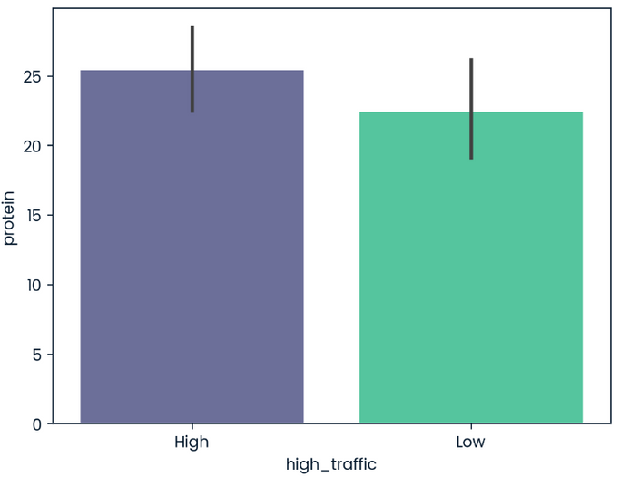
Key Findings
More calories, carbohydrate, protein lead to high traffic

Slide 6
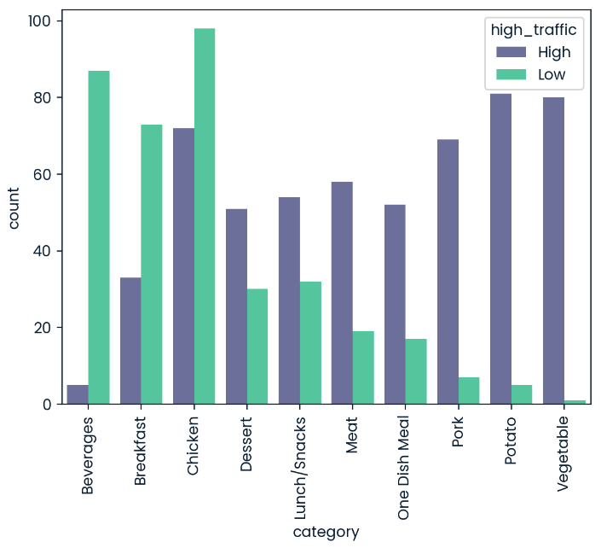
Key Findings
Recipe categories effect the most

Slide 7
Outcomes
2 models:
Logistic Regression
Random Forest Classifier
3 metrics:
Precision
Recall
F1 Score

Slide 8
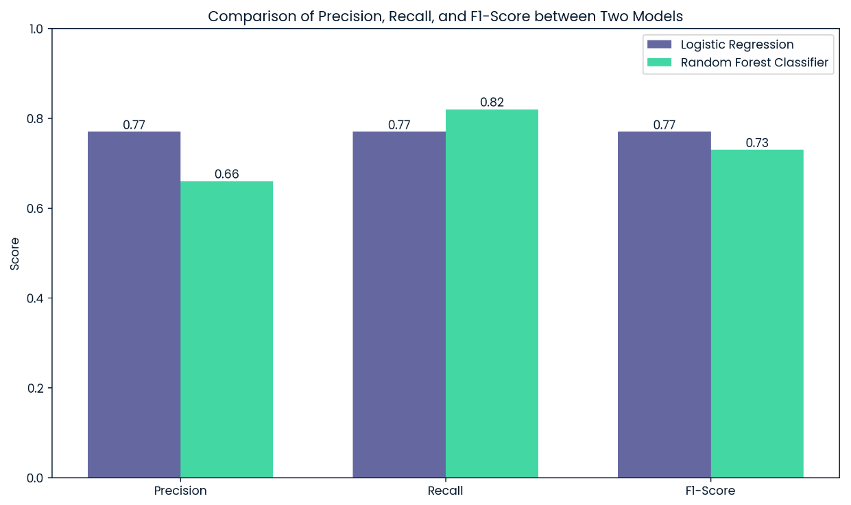
Outcomes
 | Purpose
Precision | Correct positives
Recall | Found positives
F1 Score | Balance metric

Slide 9
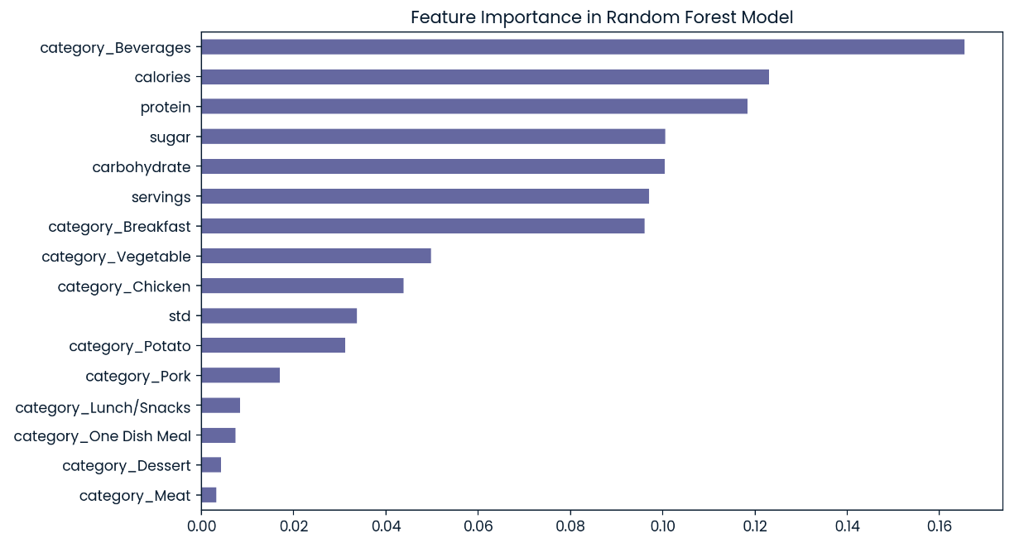
Outcomes

Slide 10
Recommendation
Here’s how we can deploy and improve the model:
Try the Random Forest model on recent data to see how well it predicts high traffic recipes. Compare its results with known high traffic recipes to check its performance.
Look for any mistakes or areas where the model didn’t perform well. Make adjustments to improve its accuracy, such as tuning parameters or adding more features.
Put the model into use by integrating it into a web application or API. This will help automate the process of identifying high traffic recipes.

